Slide 1
Cloud Migration - AWS
PRESENTED BY:
Aakanksha Pharande
Savas Erturk
Seyfullah Burul
Talwinder Singh

Slide 2
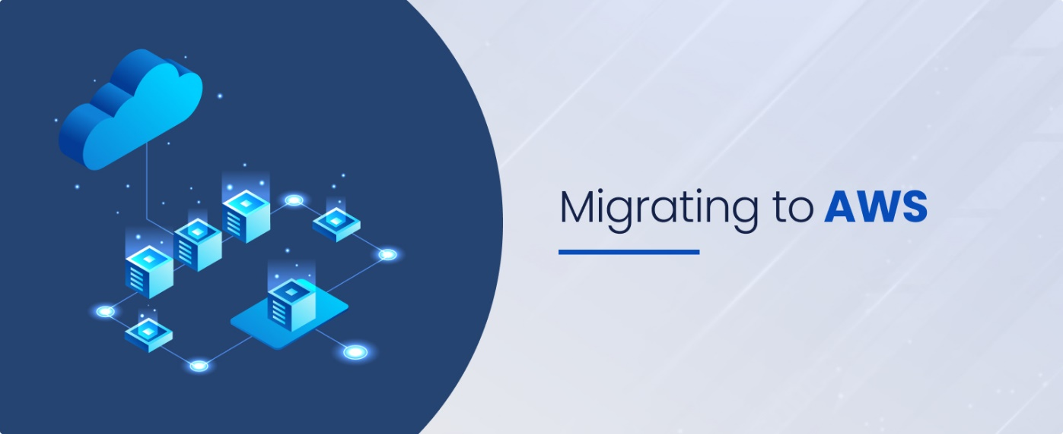
CONTENTS OF THE PRESENTATION
Company Overview
Migration Execution Plan
Compliance and Security Strategy
Cost estimation and optimization

Slide 3





COMPANY OVERVIEW
CHALLENGES
Name: GlobalTech Solutions
Industry: Multinational operations in 10 countries
Key Operations: Financial systems, inventory management, e-commerce platforms
Aging infrastructure
High
Costs
Compliance
Needs
Scalability
Issues
Disaster Recovery Risks

Slide 4
MIGRATION EXECUTION PLAN
Phase 1
Assessment of on-premises infrastructure
Phase 2
Planning the migration to AWS Cloud
Phase 3
Execution of the migration
Phase 4
Testing and Validation
Week 1 – 4
Week 5 – 10
Week 11 – 16
Week 16 – 18

Slide 5
Phase 1 Assessment of On-Premises Infrastructure

Slide 6
MIGRATION PLANNING AND ASSESSMENT
1. Inventory Assessment
AWS Application Discovery – Helps create an inventory of all applications, dependencies, and performance baselines, enabling a well-informed migration plan.
Identify VMs, ERP systems, E-commerce, Databases, Mainframe and map dependencies.
2. Risk & Compliance Analysis
Assessing risks before migration
Helps to maintain data integrity and governance
3. Stakeholder Alignment
Conducting workshops
Engaging business leaders, IT teams
Prioritizing workloads based on impact

Slide 7
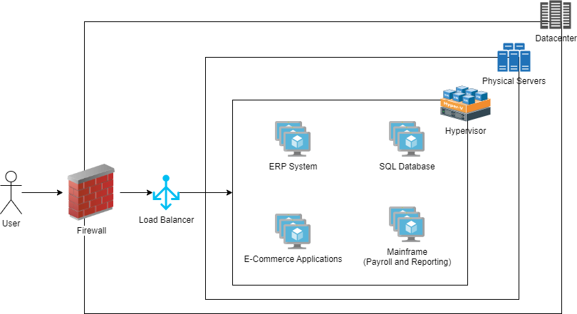
ON-PREMISES ARCHITECTURE

Slide 8





MIGRATION ASSESSMENT KEY FINDINGS
Components | Current Setup | Dependencies | Challenges | Priority
Virtual Machines | 150 VMs (Windows & Linux) | Supports ERP, e-commerce, and SQL databases | Needs workload compatibility and resource planning | High priority, core to infrastructure
Monolithic ERP System and Mainframe Application | Legacy ERP for finance and inventory management. | Integrated with SQL and other systems | Requires refactoring or rehosting for cloud | High priority for modernization
E-commerce Applications | Public-facing with strict uptime | Interconnected with the database | Minimize downtime during migration | High priority, affects revenue

Slide 9
Phase 2 Detailed Design and Preparation

Slide 10
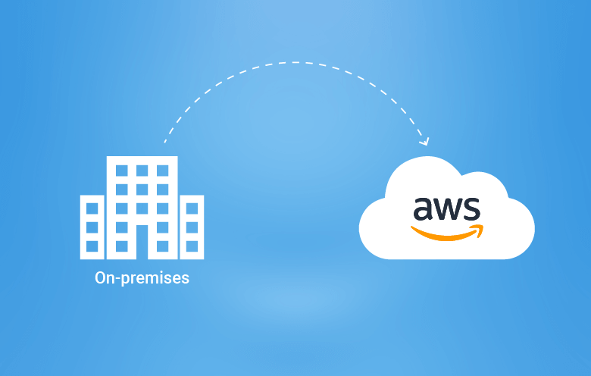
Tools Used for Migration
AWS services to be used for deployment of services: Auto Scaling Groups, Amazon Aurora, Amazon S3, Amazon ECS, Amazon RDS, Elastic Beanstalk and Amazon RDS.
Tools that will help the migration process:
AWS Migration Hub
Purpose: Centralized tracking of migration progress
Benefit: Provides visibility and control, reducing complexity
AWS Application Migration Service (AWS MGN)
Purpose: Lift-and-shift migration for on-premises workloads
Benefit: Simplifies VM migration with minimal downtime, ensuring continuity

Slide 11
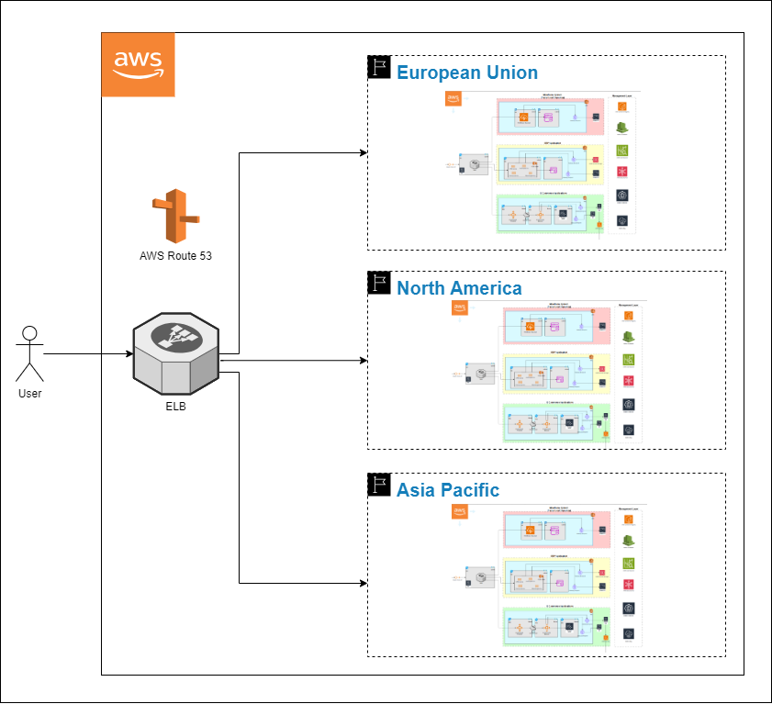
MULTI-REGION AWS ARCHITECTURE
Data Residency Compliance
Latency Optimization

Slide 12
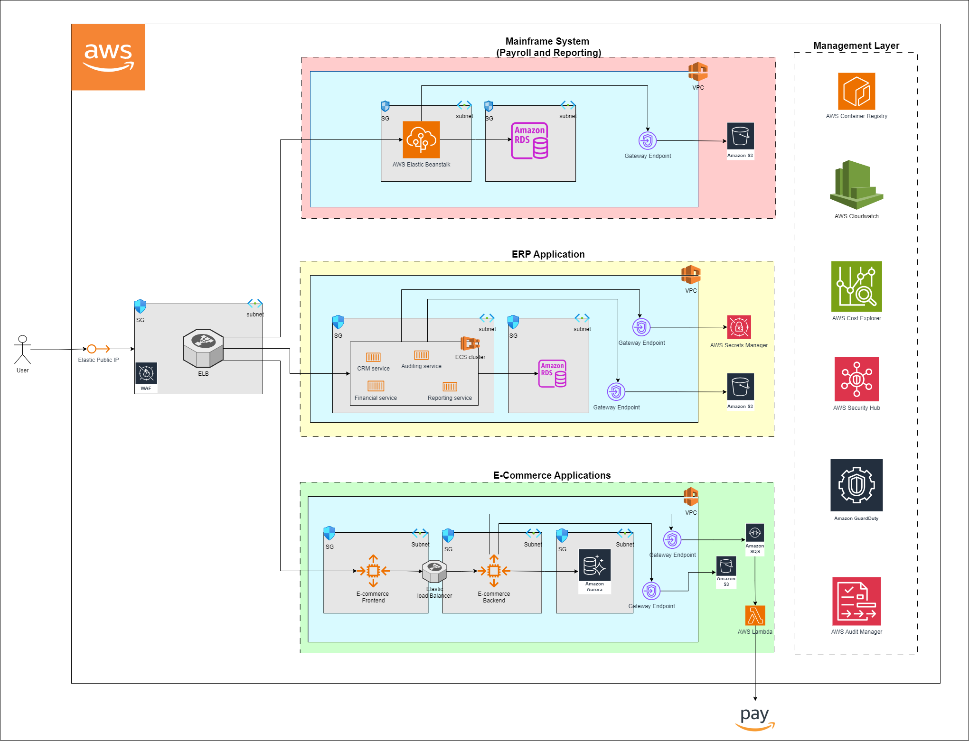
PROPOSED CLOUD ARCHITECTURE

Slide 13
Phase 3 Migration Execution

Slide 14
MIGRATION EXECUTION (E-commerce Applications Rehosting)
Auto Scaling Group
2 ASG
Database Migration to Amazon Aurora
Using AWS Database Migration Service (DMS) to migrate on-site SQL database.
Static Content Migration to Amazon S3
Copy static files to S3, update the frontend to retrieve them from S3, reducing server load and improving content delivery.
Lambda and SQS Setup
Deploy Lambda functions for backend processes and configure SQS for task queues, enhancing background process efficiency.
Define scaling policies
Set up replication to ensure no downtime.

Slide 15
MIGRATION EXECUTION (ERP Applications – Rearchitecting)
Containerize ERP services
Deploy Containers on Amazon ECS
Database Migration to Amazon RDS
Integrate with AWS Secrets Manager
Create an ECS cluster and deploy containers for each microservice.
Define task definitions and service scaling policies.
Migrate ERP data from the on-prem SQL cluster to Amazon RDS using AWS DMS.
Set up automated backups and Multi-AZ deployment for high availability.
Store and manage ERP secrets in Secrets Manager.
Update application code to retrieve secrets dynamically.
CRM, Auditing, Financial, Reporting – broken into microservices
Packaging each one of them into Docker container.
Storing the images in AWS Container Registry

Slide 16
MIGRATION EXECUTION (Mainframe System – Rearchitecting )
Deploy on AWS Elastic Beanstalk
Database Migration to Amazon RDS
Store Reports on Amazon S3
Deploy the mainframe app to Elastic Beanstalk; configure env variables, load balancing, and auto-scaling.
Migrate payroll data to Amazon RDS using AWS DMS; set up read replicas for reporting.
Save reports to S3; configure lifecycle policies for archiving or deletion.

Slide 17
Phase 4 Validation and Testing

Slide 18
VALIDATION AND TESTING
E-commerce Applications:
ERP Applications:
Mainframe System:
Perform end-to-end testing in staging: validate connectivity, database integrity, and static content.
Test each microservice and the full ERP workflow; ensure data consistency in RDS.
Run test payroll cycles; verify seamless data processing, storage, and reporting.

Slide 19
COMPLIANCE WITH INTERNATIONAL STANDARDS General Data Protection Regulation (GDPR)
Data Location:
Access Control and Logging:
Signing a Data Processing Agreement with the cloud provider that explains how they process the company's data by the GDPR and also fulfill the obligations of these agreements. .
Data encryption services are essential for enhancing security and ensuring compliance with legal regulations.
Data Encryption:
AWS offers tools like CloudTrail and CloudWatch Logs to track and log data access, helping to monitor who accessed personal data and when, in line with GDPR requirements.
Data Processing Agreement (DPA):
It refers to where personal data is stored and processed, specifying the geographical locations and countries involved.

Slide 20
COMPLIANCE WITH INTERNATIONAL STANDARDS​ Health Insurance Portability and Accountability Act (HIPAA)
Data Integrity: Health information must be accurate and immutable. The integrity of the data should be ensured through security measures.
Disaster Recovery: HIPAA mandates that health data be backed up and recoverable in case of a disaster to prevent data loss.
Access Control: Only authorized individuals should be able to access health data. HIPAA requires the monitoring and recording of these accesses.
Patients' Rights: HIPAA grants patients the right to access their health information and allows them to monitor how their data is used.

Slide 21
DEVELOPMENT OF SECURITY MEASURES ​ Encryption
Encrypting Data in Transit: Protect data while it’s being transferred over the internet by using secure communication protocols like SSL/TLS.
Encrypting Data at Rest: Using an encryption service to ensure that data is encrypted when stored on servers, making it unreadable to unauthorized users.
End-to-End Encryption for Sensitive Data: Sensitive data should be encrypted from one end to the other, so only the authorized parties can access it.

Slide 22
DEVELOPMENT OF SECURITY MEASURES​ Identity and Access Management (IAM)
Set Up IAM Roles: We'll define access permissions using IAM roles and policies to ensure users have only the necessary access, reducing the risk of unauthorized access.
Use Multi-Factor Authentication (MFA): MFA will be required for all users, adding an extra layer of security by verifying identity through two forms of identification.
Identity Federation: Identity Federation will allow users to log in with existing corporate accounts, simplifying login management and enhancing access security.

Slide 23
DEVELOPMENT OF SECURITY MEASURES​ Disaster Recovery and Backup
Backup Data Regularly:
Disaster Recovery Plan:
Test Disaster Recovery:
Using Amazon S3 and RDS for automatic, multi-region backups to prevent data loss.
A disaster recovery plan will ensure quick recovery with AWS Backup and Route 53 for minimal downtime.
Regular recovery tests using AWS DRS, CloudFormation, and Lambda will ensure reliable and fast system restoration.

Slide 24
COMPLIANCE ROADMAP
​
Phase 3: Execution and Validation (Weeks 11-16)
Review the company’s data to identify where sensitive information is stored. Set up a compliance team to ensure all regulations are followed during the cloud migration.
Make sure that security features like data encryption, access control, and backup strategies are included in the cloud infrastructure. Conduct a Data Protection Impact Assessment (DPIA) to identify any risks related to the company’s data processing.
Test the cloud setup to ensure all security and compliance requirements are in place. Perform internal audits to make sure everything is working as planned and there are no compliance issues.
Phase 1: Discovery and Assessment (Weeks 1-4)
Phase 2: Architecture and Design (Weeks 5-10)

Slide 25
DATA GOVERNANCE POLICIES
​
Data Ownership:
Clearly define who owns the data and is responsible for its protection.
Data Retention:
Establish a policy to keep data only as long as needed, and automatically archive or delete old data after a certain period.
Access Control and Monitoring:
Set clear rules for who can access data and monitor these activities to ensure they follow the rules.
Audit and Reporting:
Use tools to automatically monitor and create reports to make sure all compliance regulations are being met.

Slide 26
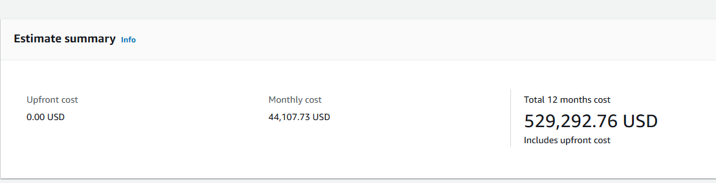
AWS Cost Analysis: An Insight into Estimated Cloud Expenditures
Cloud computing provides scalable and flexible solutions for businesses, but it comes with associated costs that require careful analysis. This presentation breaks down the cost estimates for AWS services used in three major regions: US East (Ohio), Europe (Frankfurt), and Asia Pacific
Monthly Cost: $44,107.73
12-Month Total Cost: $529,22.76
Services covered: AWS Fargate, Amazon RDS for SQL Server, EC2, S3, Route 53, Elastic Graphics, and Elastic Load Balancing.
Notes:
This analysis explores how AWS services can be utilized to achieve cost efficiency, scalability, and performance for cloud migrations and deployments. By focusing on cost optimization strategies and leveraging AWS’s wide array of managed services, organizations can maximize their return on investment.

Slide 27
Why AWS?
AWS offers scalable, reliable, and cost-effective cloud solutions.
Provides a wide array of services, including compute, storage, and databases, to meet diverse needs.
Cost analysis is critical for selecting the best pricing and commitment options for migration and deployment.
Trusted by leading enterprises for innovation and operational efficiency.

Slide 28
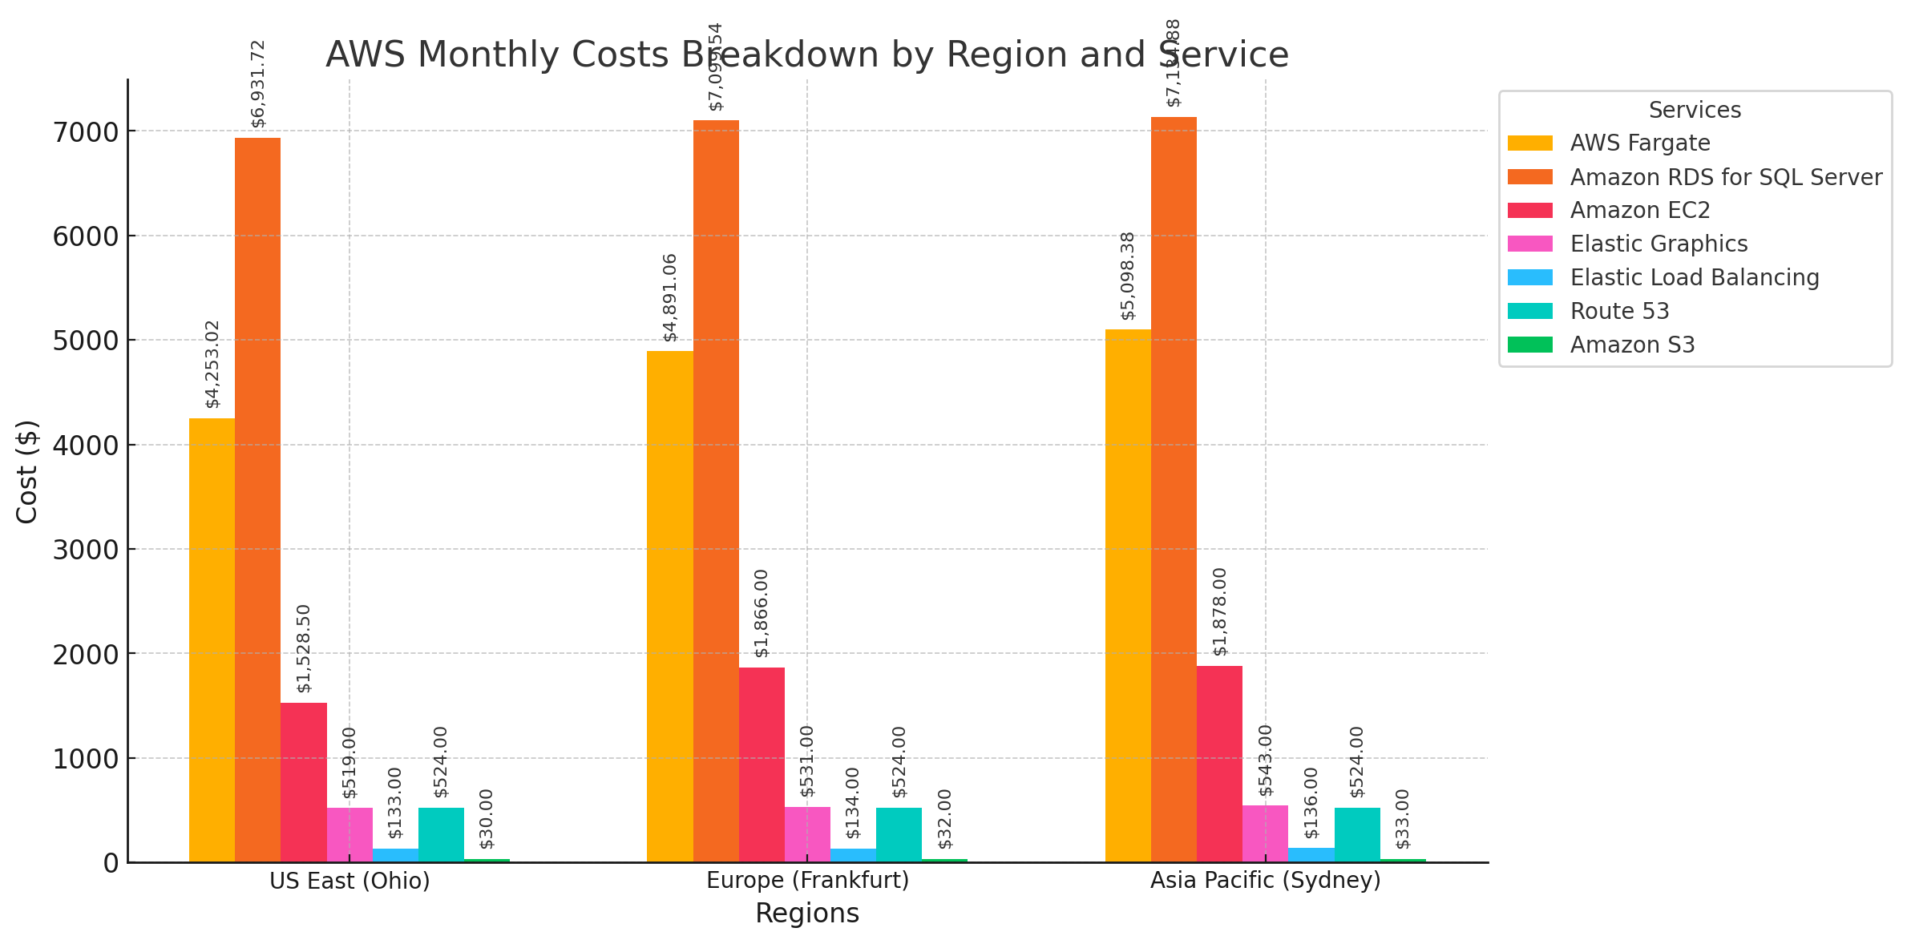
Cost Breakdown by Service
AWS Fargate:
US East (Ohio): $4,253.02/month
Europe (Frankfurt): $4,891.06/month
Asia Pacific (Sydney): $5,098.38/month
Amazon RDS for SQL Server:
US East (Ohio): $6,931.72/month
Europe (Frankfurt): $7,099.54/month
Asia Pacific (Sydney): $7,134.88/month
Amazon EC2: US East (Ohio): $1,528.50/month
Europe (Frankfurt): $1,866.00/month
Asia Pacific (Sydney): $1,878.00/month
Other Services: Elastic Graphics: ~$519–$543/month across regions. Elastic Load Balancing: ~$133–$136/month across regions. Route 53: $524/month consistently in all regions. Amazon S3: $30–$33/month across regions.

Slide 29
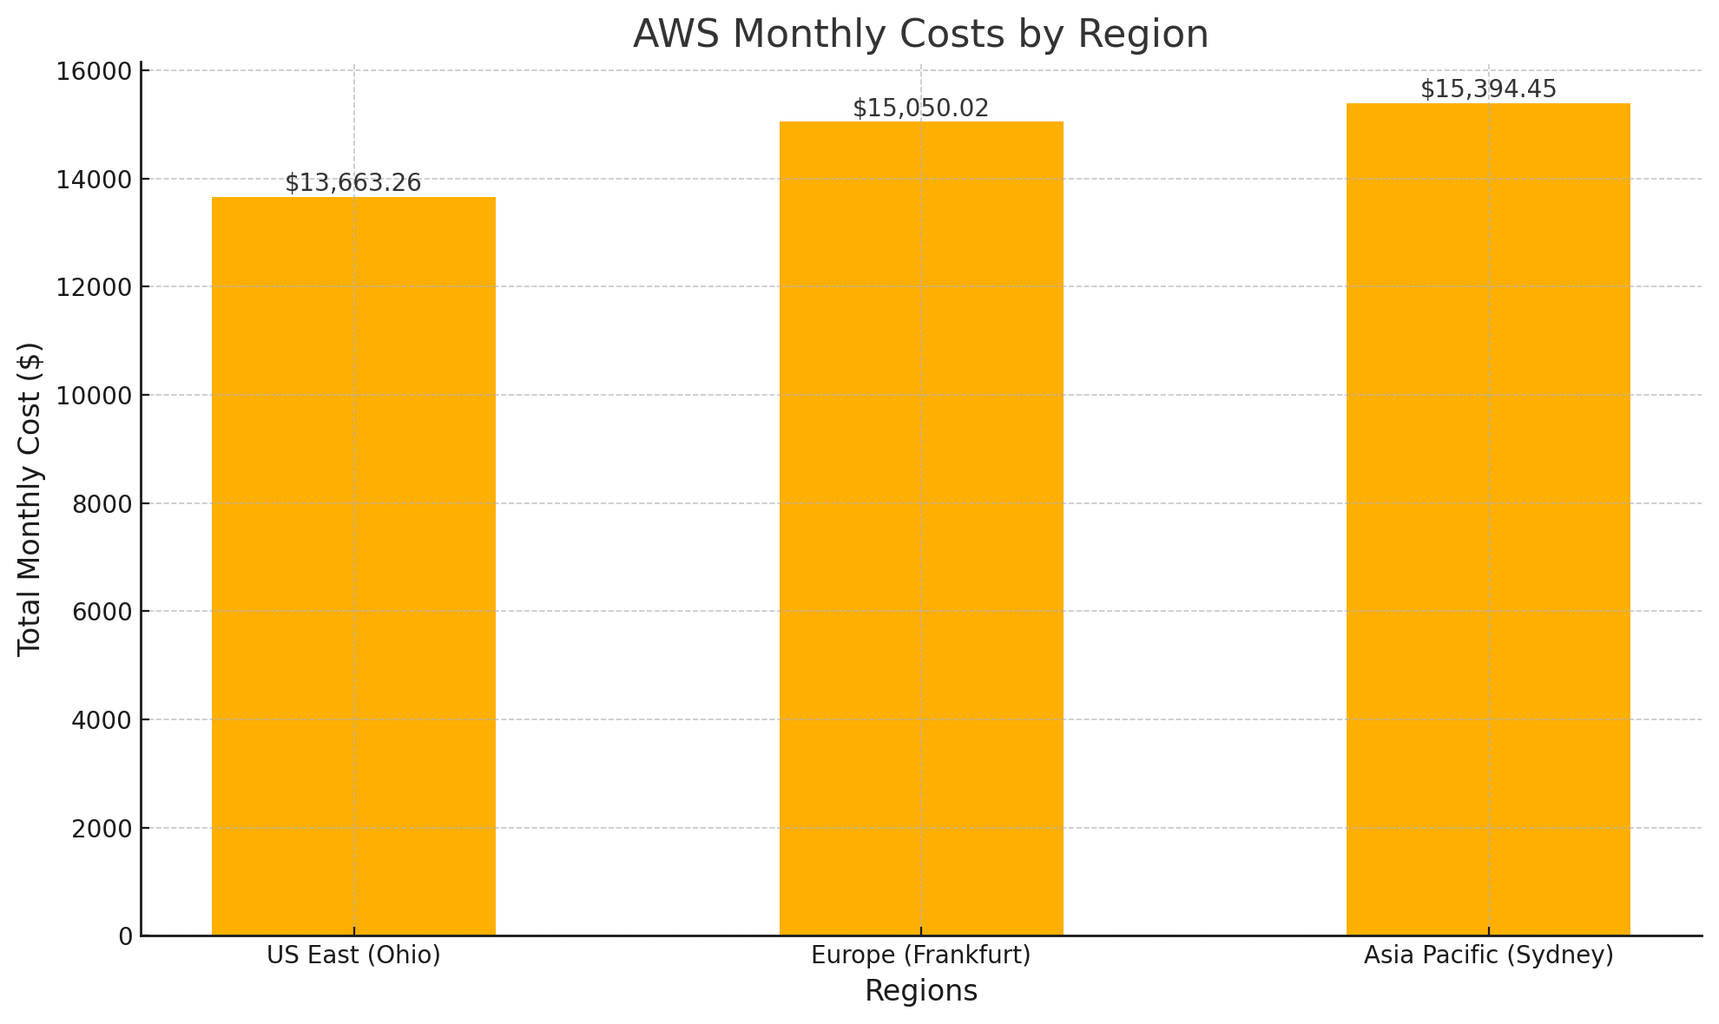
Regional Comparison
AWS costs are distributed across three regions with slight variations based on service usage and configurations:
North America (US East - Ohio):
Total Monthly Cost: $13,663.26
Europe (Frankfurt):
Total Monthly Cost: $15,050.02
Asia Pacific (Sydney):
Total Monthly Cost: $15,394.45

Slide 30
Analysis of AWS Cost Drivers
AWS cost analysis reveals the following:
Primary Cost Drivers:
Amazon RDS for SQL Server: Significant due to multi-AZ deployment and Enterprise edition licensing.
AWS Fargate: High utilization for containerized workloads.
Amazon EC2: Moderate costs from 150 instances per region.
Secondary Costs:
Elastic Graphics, Load Balancers, Route 53, and S3 make smaller contributions but remain consistent across regions.
Optimization Opportunities:
Savings Plans: Adopt reserved pricing for RDS and EC2.
S3 Optimization: Transition to Glacier for infrequently accessed data.
Task Scheduling: Reduce idle Fargate instances.

Slide 31
Questions

